Slide 1
Giới thiệu Về Android, LibGdx
Đỗ Văn Trung

Slide 2
Introduce Android

Slide 3
Introduce libGDX
a cross-platform game development library written in Java
with some JNI code for performance hungry sections.
desktop, Android and HTML5 base on OpenGL
developed entirely on the desktop (then only 6 lines of code to run on Android or HTML5)

Slide 4
Goals & Features
I. General
Cross-platform development for Windows, Linux, OSX and Android.
Multiple backends: Jogl, LWJGL, GWT, Android API
Write and test your application on the desktop, deploy to Android, HTML5.

Slide 5
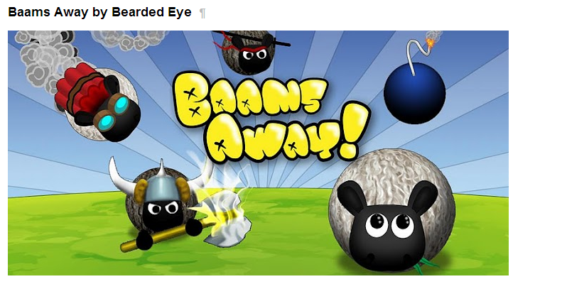
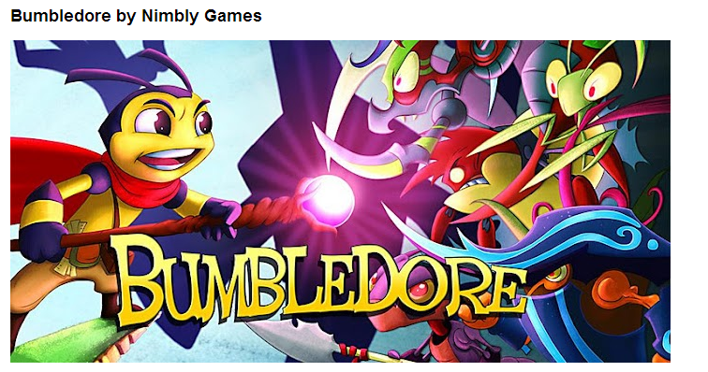
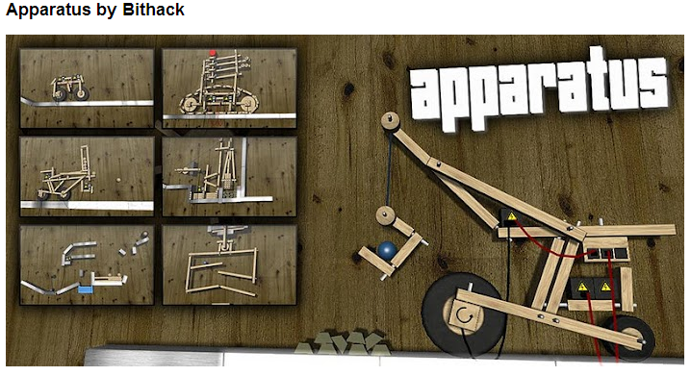
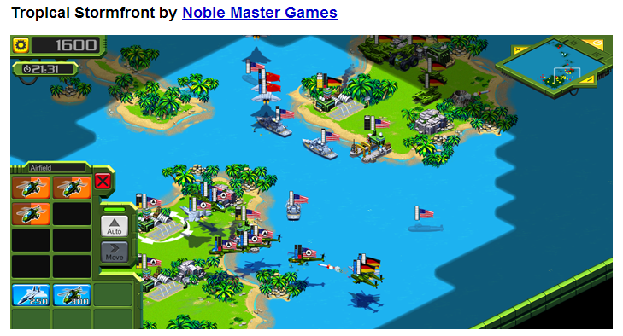
Some game base on libGDX

Slide 6
Other Engines

Slide 8
Prerequisites
JDK
Eclipse
Android SDK and Eclipse ADT Plugin
Google Web Toolkit

Slide 9
LibGdx Setup
Download libgdx.jar at: http://libgdx.badlogicgames.com/nightlies/libgdx-nightly-latest.zip
2 way to set-up:
Use LibGdx-Setup-UI
Manual

Slide 10
libGDX Setup UI
Run jar file: gdx-setup-ui.jar
Specify your project's configuration
Specify the libgdx stable/nightly release zip file
Hit the "Generate projects" button
Import project to Eclipse: File -> Import -> Existing Projects into Workspace

Slide 11
Porject Layout
Core project ("my-gdx-game") Android
project ("my-gdx-game-android")
Desktop project ("my-gdx-game-desktop")
HTML5 project ("my-gdx-game-html")

Slide 12
Running Your Application
Desktop:
Right click the desktop project, Run As -> Java Application.
Select the desktop starter class
Android
Right click Android project, Run As -> Android Application

Slide 13
Manual Setup
Main project setup
Desktop project setup
Android project setup
Asset folder setup
Creating a game
Running the game on the desktop
Running the game on Android

Slide 14
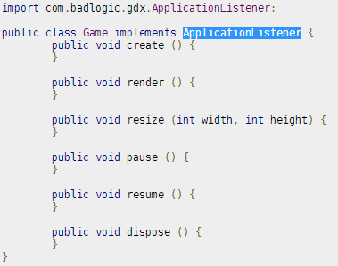
Creating a game
Implements ApplicationListener

Slide 15
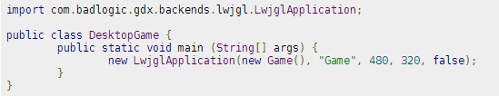
Game on Desktop
Use LwjglApplication or JoglApplication
Lwjgl: Lightweight Java Game Library
Jogl: Java Binding for the OpenGL

Slide 16
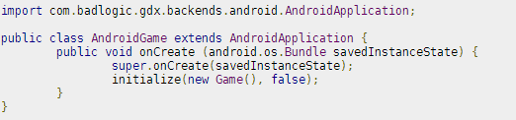
Game on Android

Slide 17
First Program – my-gdx-game
Use libGDX Setup UI.
Contain 4 project:
my-gdx-game: core project. Contain all code of game (except Starter Class, ex: Main(Desktop), Activity(android)...)
my-gdx-game-android: Android project
my-gdx-game-desktop: Destkop project
My-gdx-game-html: HTML5 project

Slide 18
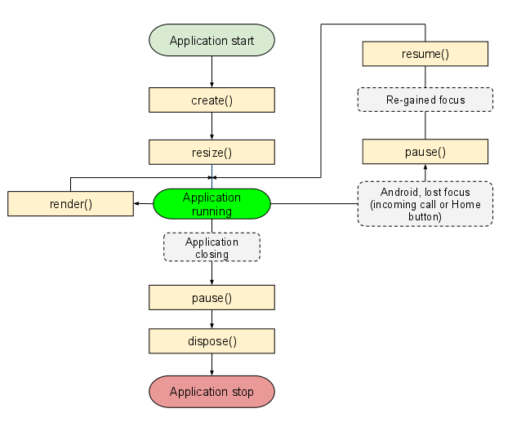
Life cycle

Slide 19
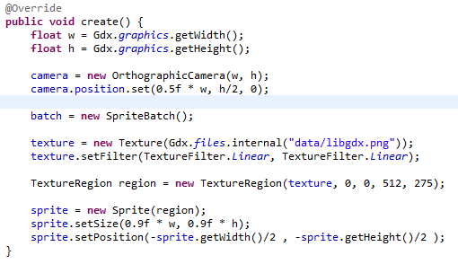
OnCreate()
Get width, height of game’s screen

Slide 20
Explain code
float w = Gdx.graphics.getWidth();
float h = Gdx.graphics.getHeight();
Get size of game’s screen
Other propertis of Gdx class:
Gdx.app
Gdx.log
Gdx.files

Slide 21
Explain code
camera = new OrthographicCamera(w, h);
Create camera with specify size.
camera.position.set(0.5f * w, h/2, 0);
Set Camera position

Slide 22
Camera

Slide 23
Texture Region, Sprite
texture = new Texture(Gdx.files.internal("data/libgdx.png"));
Create Texture from file
texture.setFilter(TextureFilter.Linear, TextureFilter.Linear);
Set filter

Slide 24
Texture
ecodes an image file and loads it into GPU memory.
image file should be placed in the "assets" folder
The image's dimensions must be a power of two (16x16, 64x256, etc).

Slide 25
Texture Region
describes a rectangle inside a texture
useful for drawing only a portion of the texture.
Ex :
TextureRegion region = new TextureRegion(texture, 0, 0, 512, 275);

Slide 26
Spirte
describes both a texture region, the geometry where it will be drawn, and the color it will be drawn.
Ex:
sprite = new Sprite(region);
sprite.setSize(0.9f * w, 0.9f * h);
sprite.setPosition(-sprite.getWidth()/2 , -sprite.getHeight()/2 );

Slide 27
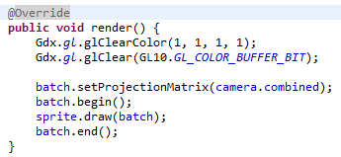
render()

Slide 28
Clearing The Screen
Gdx.gl.glClearColor(1, 1, 1, 1);
set color buffer to a solid white color:
Gdx.gl.glClear(GL10.GL_COLOR_BUFFER_BIT);
Clear buffer bit

Slide 29
SpriteBatch
takes care of all the steps needed to achieve texture mapping and displaying texture mapped rectangles on the screen.
Ex:
batch = new SpriteBatch();// create
batch.begin();
sprite.draw(batch);
....
batch.end();
Source bai 1.7z

Slide 30
Lesson 2: Fundamental
SpriteBatch, TextureRegions, Sprite
NinePathes
Bitmap Font
Texture Atlases
Packing Atlases

Slide 31
SpriteBatch
Ex:
public void create () { batch = new SpriteBatch(); } public void render () { Gdx.gl.glClear(GL10.GL_COLOR_BUFFER_BIT); batch.begin(); // Drawing goes here! batch.end(); }
All SpriteBatch drawing calls must be made between the begin and end methods.

Slide 32
Texture
decodes an image file and loads it into GPU memory. T
image file should be placed in the "assets" folder.
The image's dimensions must be a power of two (16x16, 64x256, etc).

Slide 33
Texture
Draw Texture:
private Texture texture; ... texture = new Texture(Gdx.files.internal("image.png")); ... batch.begin(); batch.draw(texture, 10, 10); batch.end();
Should use draw texture by Sprite

Slide 34
TextureRegion
describes a rectangle inside a texture and is useful for drawing only a portion of the texture
Ex:
private TextureRegion region; ... texture = new Texture(Gdx.files.internal("image.png")); region = new TextureRegion(texture, 20, 20, 50, 50); ... batch.begin(); batch.draw(region, 10, 10); batch.end();
Should use Texture Atlas to create Texture Region

Slide 35
Sprite
describes both a texture region, the geometry where it will be drawn, and the color it will be drawn.
Use:
private Sprite sprite; ... texture = new Texture(Gdx.files.internal("image.png")); sprite = new Sprite(texture, 20, 20, 50, 50); sprite.setPosition(10, 10); sprite.setRotation(45); ... batch.begin(); sprite.draw(batch); batch.end();

Slide 36
Tinting
Use:
sprite.setColor(0, 0, 1, 1);
batch.setColor(1, 0, 0, 1);
Color using RGBA values between 1 and 0

Slide 37
Blending
Blending is enabled by default.
Blending: is translucent portions of the texture are merged with pixels already on the screen at that location.
a performance increase by disabling blending
Use
batch.disableBlending(); backgroundSprite.draw(batch); batch.enableBlending();

Slide 38
NinePatch
an image with defined "stretchable" areas.
A NinePatch is used in Scene2d, including:
Image
Buttons
ScrollPanes
Textfields

Slide 39
NinePatch

Slide 40
Bitmap Font
Texture for Text
likes a texture atlas
Created by Hiero

Slide 41
Texture Atlas
store many smaller images on a larger image
Use Texture Packer to create.
Output: file “pack” and other PNG file

Slide 42
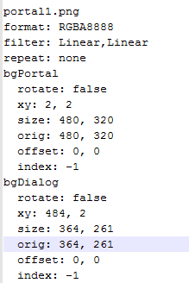
Pack file-example

Slide 43
How to use Texture Atlas
TextureAtlas atlas; atlas = new TextureAtlas(Gdx.files.internal(“data/pack"));
Create TextureRegion:s AtlasRegion region = atlas.findRegion(“name");
Create Sprite: Sprite sprite = atlas.createSprite(“name2");
Create 9Patch: NinePatch patch = atlas.createPatch(“name3");

